Slide 1




Week-5 (Discussion)
26th August, 2024
Introduction to Machine Learning
Prof. Balaraman Ravindran
Professor and Head of the Department
Department of Data Science and Artificial Intelligence
IIT Madras
Ayan Paul
PMRF Research Scholar
IIT Kharagpur

Slide 2
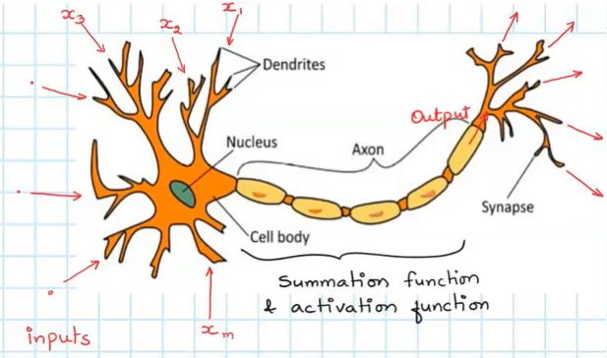
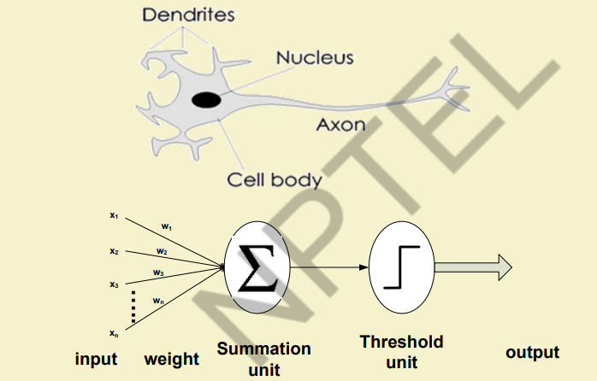
Artificial neural network
In machine learning, a neural network (also called artificial neural network, ANN) is a model inspired by the structure and function of biological neural networks in animal brains.
Neurons
An ANN consists of connected units or nodes called artificial neurons, which loosely model the neurons in the brain.
Functioning of the neural networks
Each artificial neuron receives signals from connected neurons, then processes them and sends a signal to other connected neurons.
The “signal” is a real number, and the output of each neuron is computed by some function of the sum of its inputs, called the activation function.
The strength of the signal at each connection is determined by a weight, which adjusts during the learning process.

Slide 3
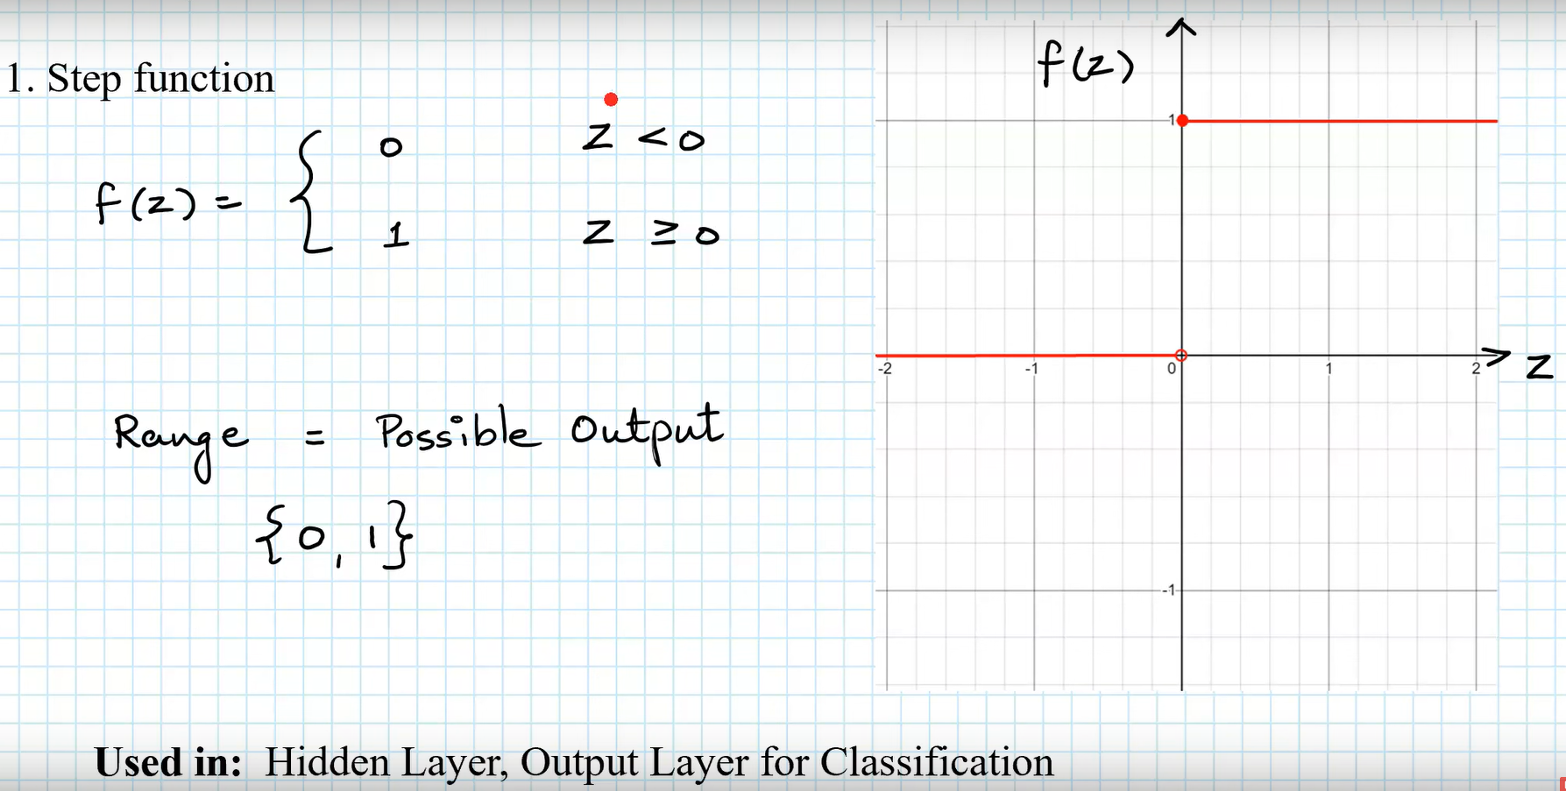
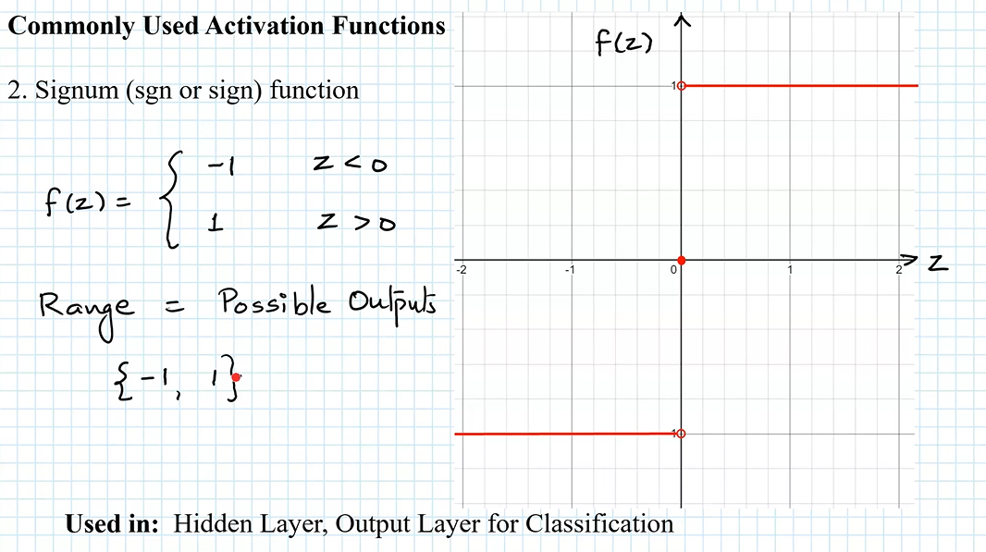
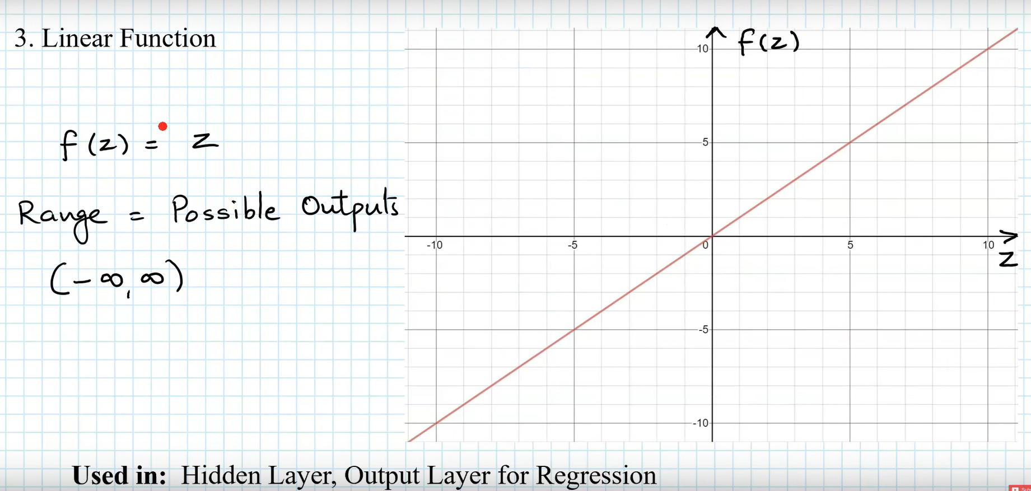
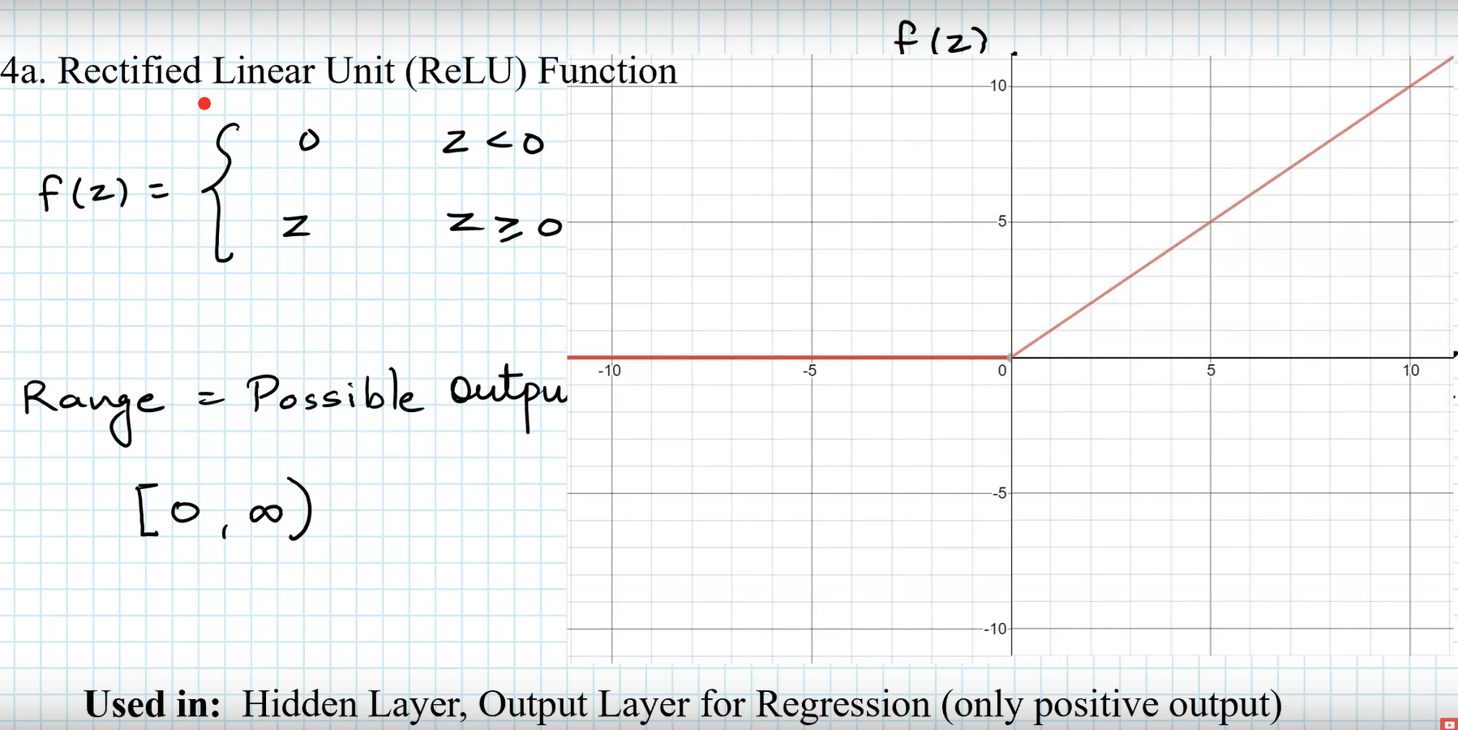
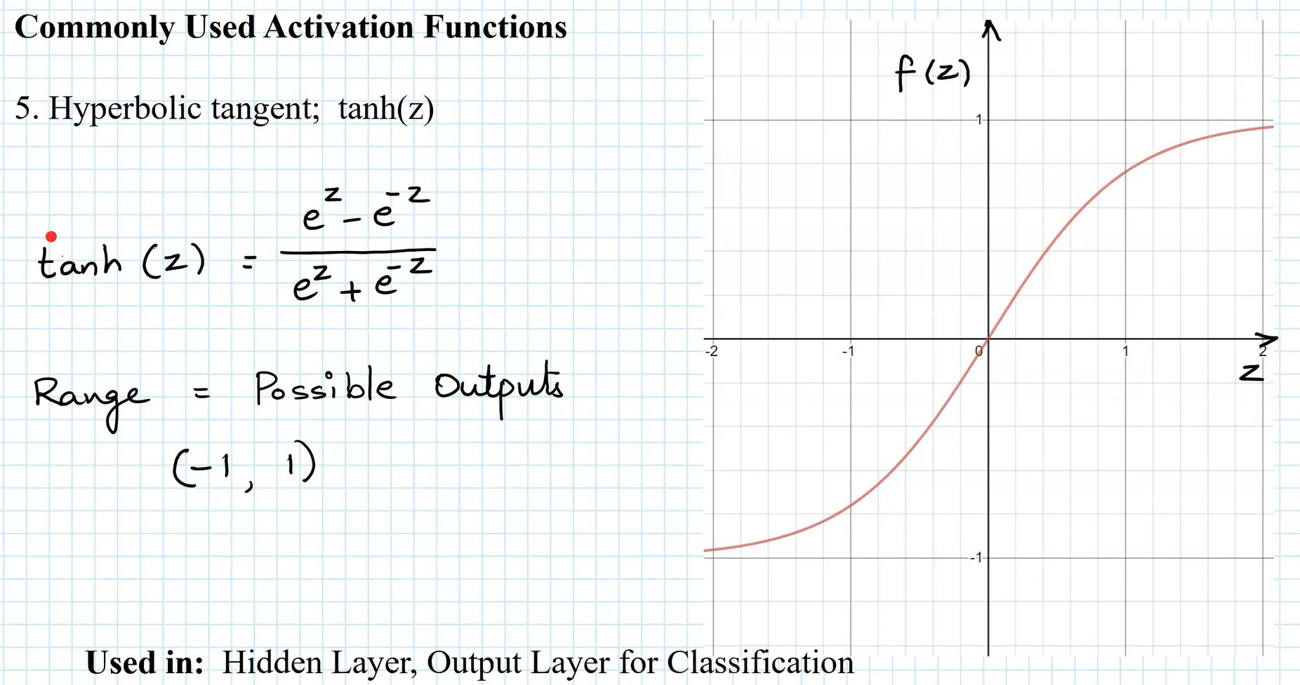
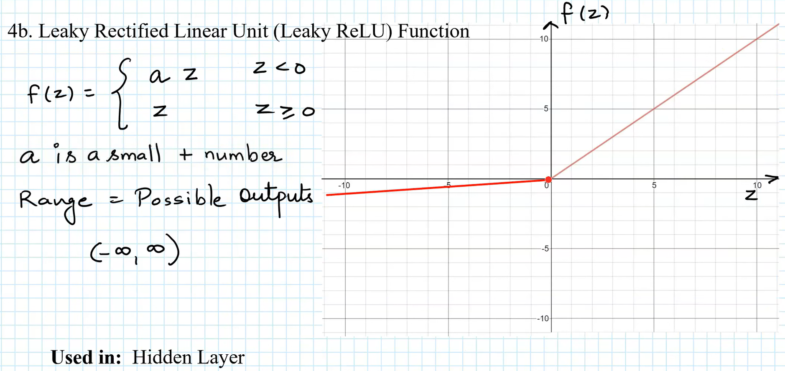
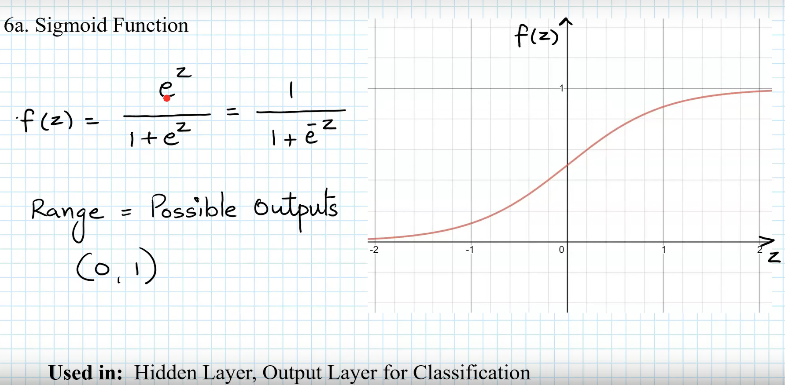
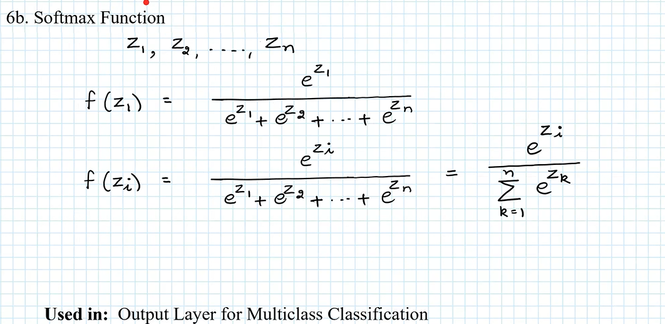
Activation functions

Slide 4
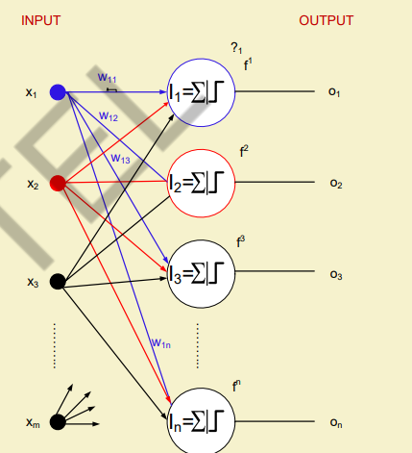
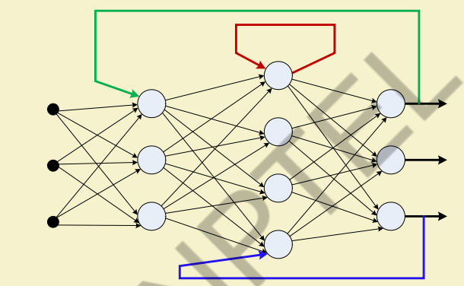
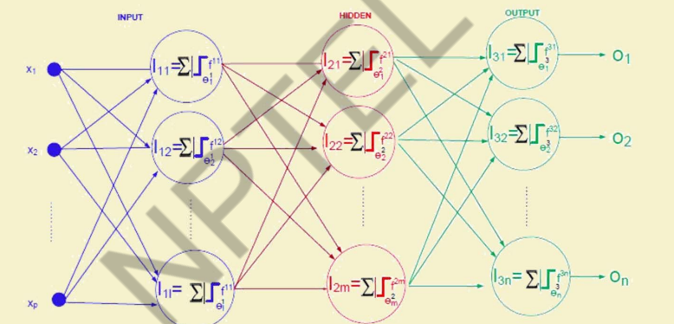
Neural network architectures
Typically, neurons are aggregated into layers. Different layers may perform different transformations on their inputs.
Signals travel from the first layer (the input layer) to the last layer (the output layer), possibly passing through multiple intermediate layers (hidden layers).
A network is typically called a deep neural network if it has at least two hidden layers.

Slide 5
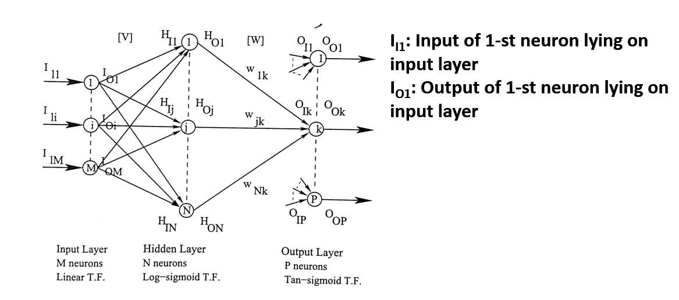
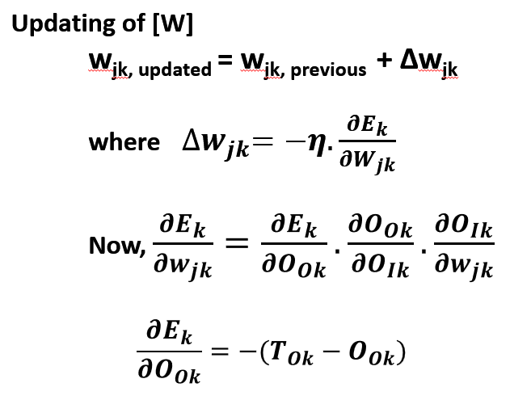
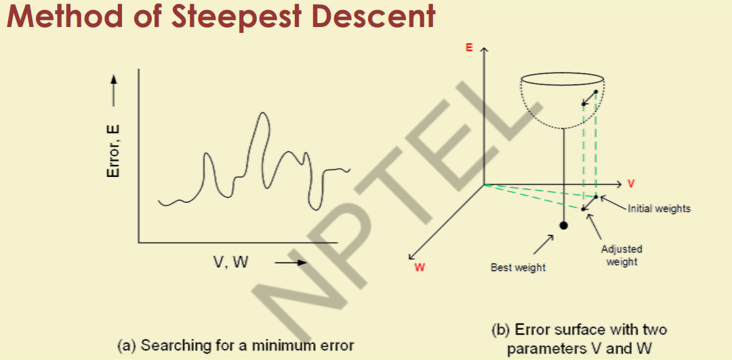
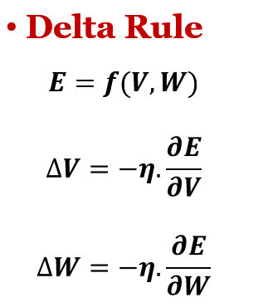
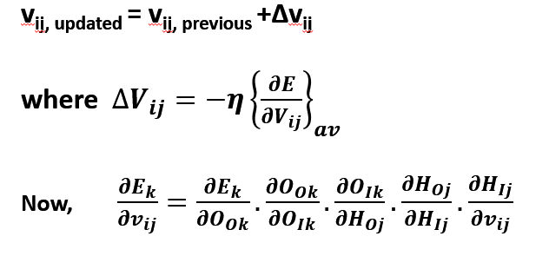
Learning in MLFFNN

Slide 6
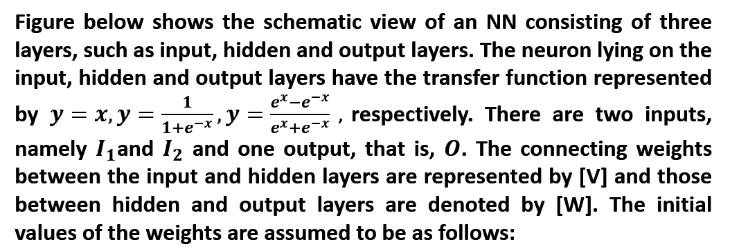
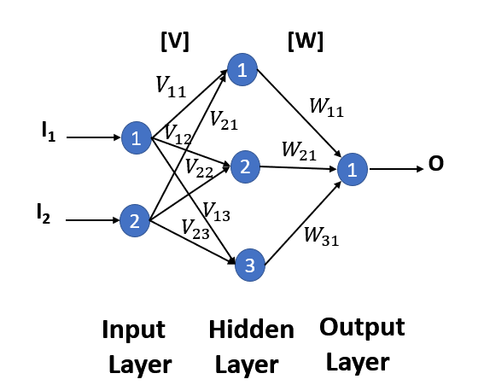
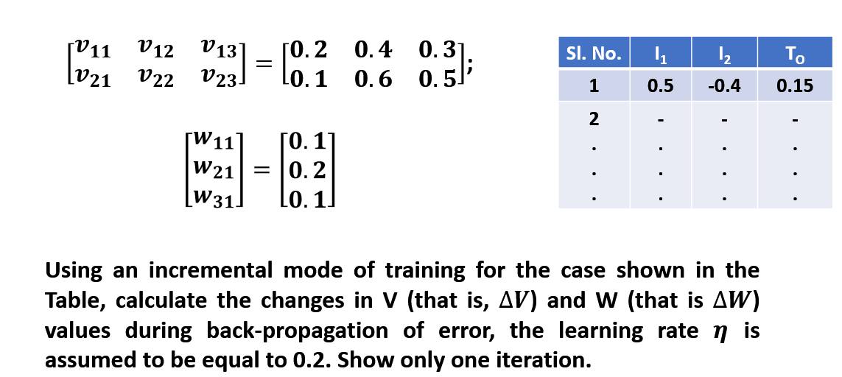
Numerical Example

Slide 7
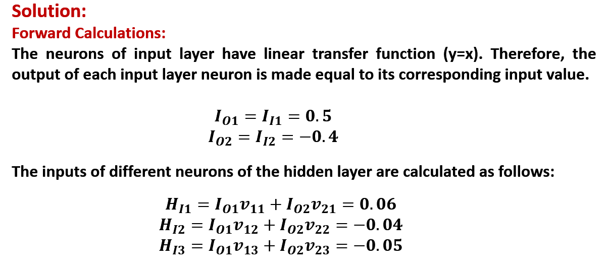
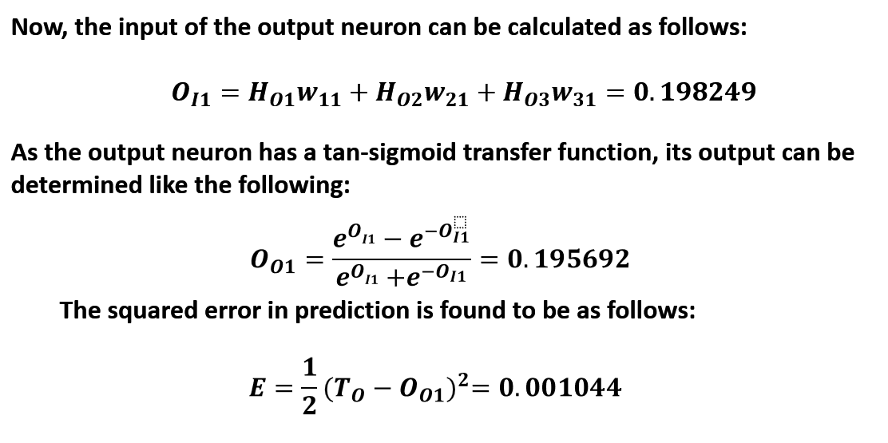
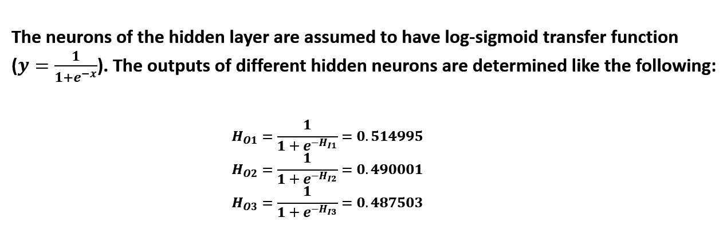

Slide 8
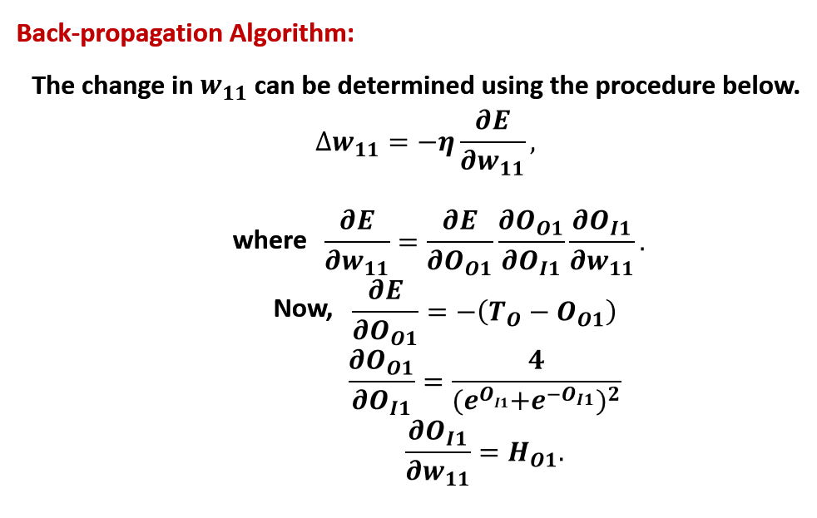
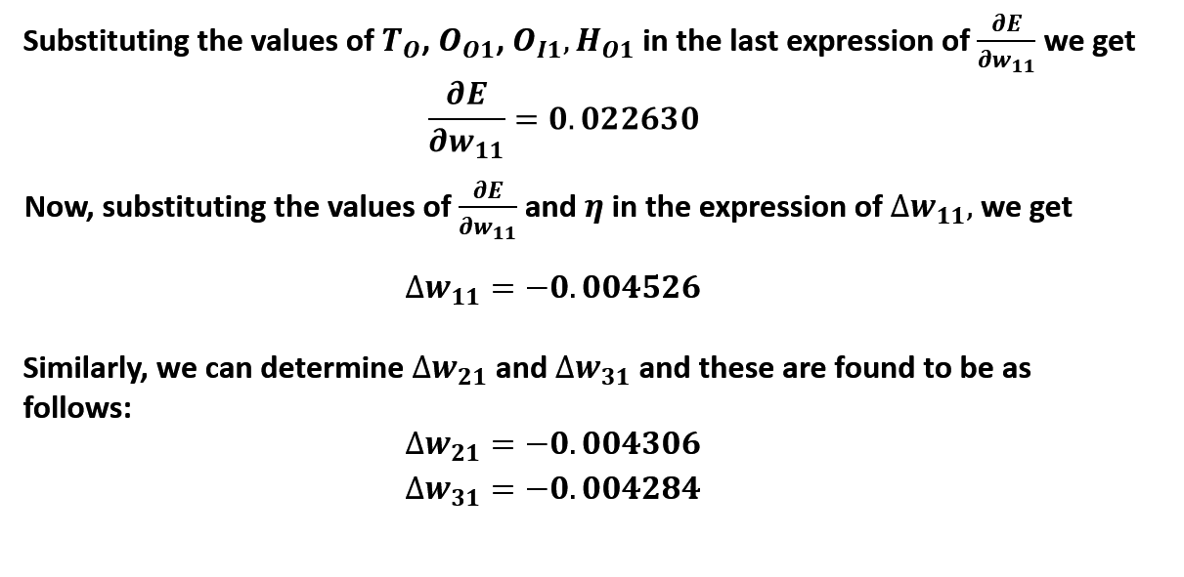

Slide 9
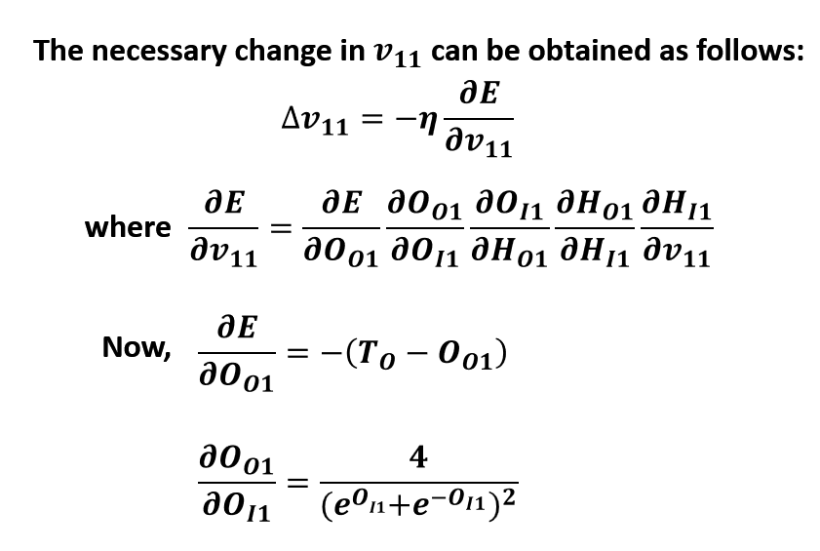
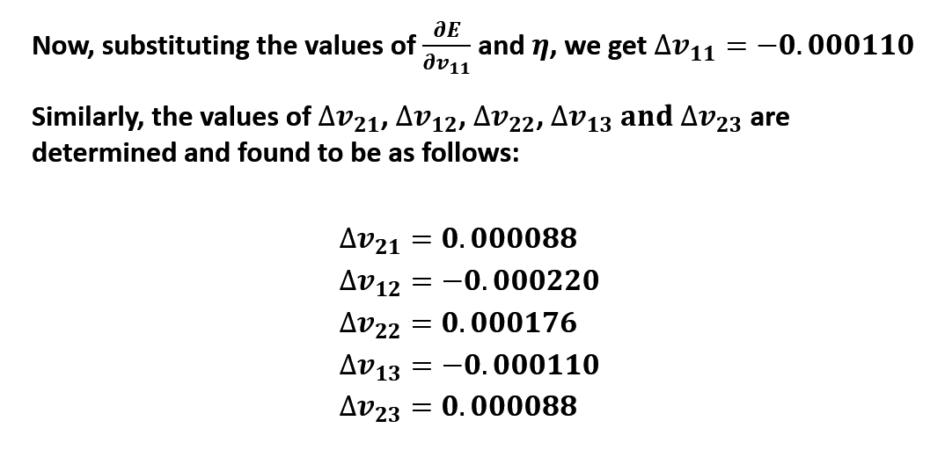
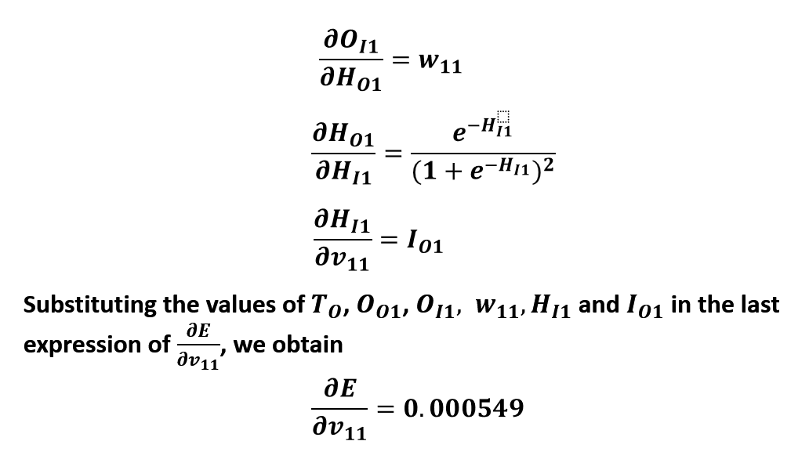

Slide 10
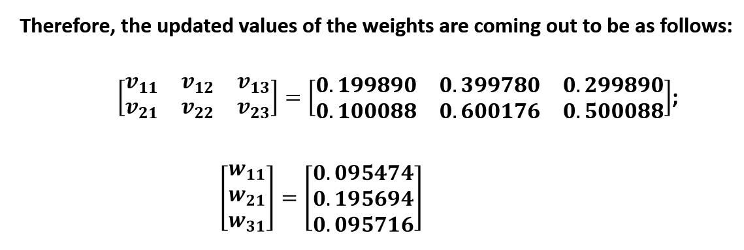

Slide 11
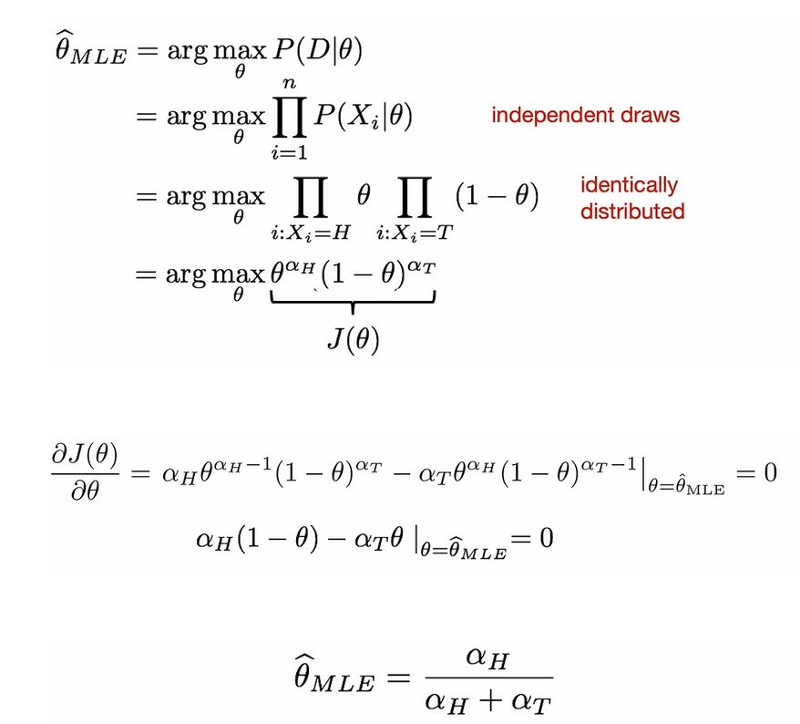
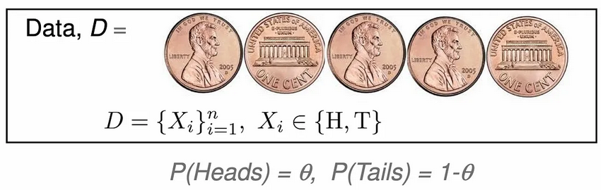
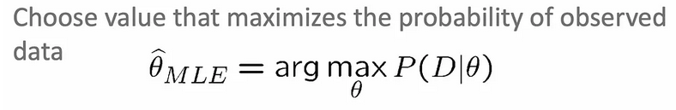
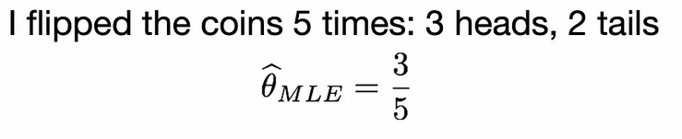
Maximum Likelihood Estimation (MLE)
It is a method for estimating the parameters of a statistical model, given a dataset.
The goal of MLE is to find the parameter values that maximize the likelihood of the data, given the model. This is done by choosing the values of the parameters that make the observed data most probable.
Example

Slide 12
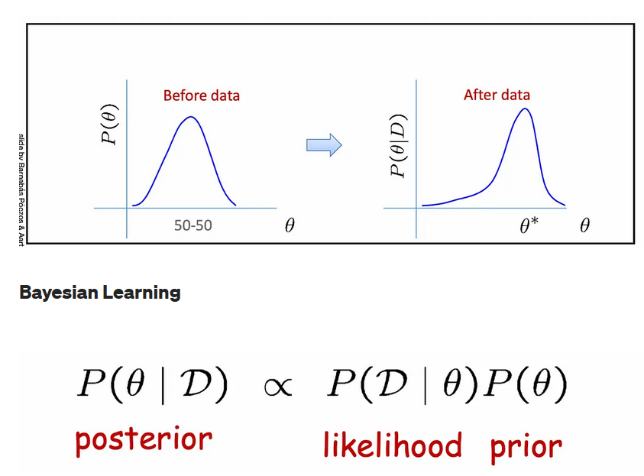
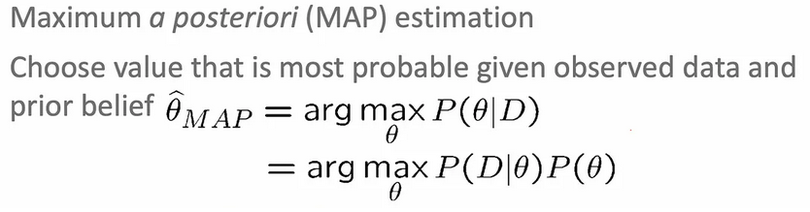
Maximum A Posteriori (MAP)
It is a method for estimating the parameters of a statistical model, given a dataset and some prior knowledge about the model.
The goal of MAP is to find the parameter values that maximize the posterior probability of the data, given the model and the prior knowledge. This is done by choosing the values of the parameters that make the observed data most probable, given the prior knowledge.
MAP is similar to MLE , but it incorporates prior knowledge about the model into the estimation process.
MLE and MAP are same when prior is uniform distribution.
This can be useful in cases where the data is limited or noisy, or where there is a need to incorporate domain-specific knowledge into the model.

Slide 13
Topics on which Week 5 Assignment Questions are based
Artificial Neural Networks
Parameter Estimation

Slide 14
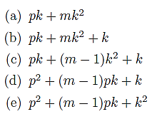
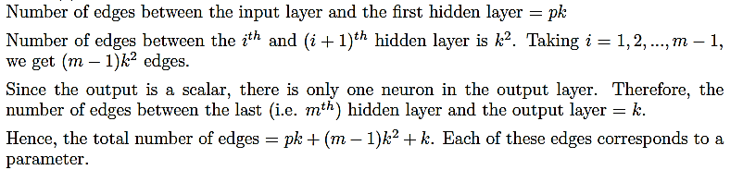
QUESTION 1
Consider a feedforward neural network that performs regression on a p-dimensional input to
produce a scalar output. It has m hidden layers and each of these layers has k hidden units.
What is the total number of trainable parameters in the network? Ignore the bias terms.
SOLUTION 1
CORRECT ANSWER 1
c)

Slide 15
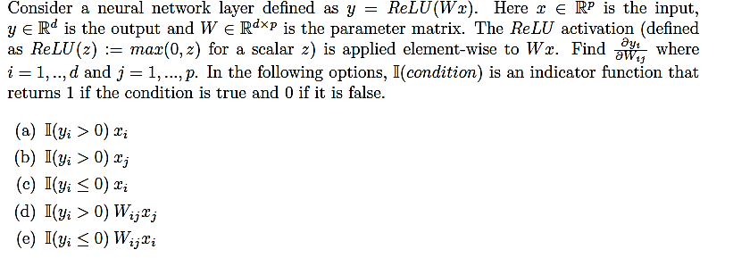
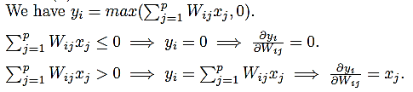
QUESTION 2
SOLUTION 2
CORRECT ANSWER 2
b)

Slide 16
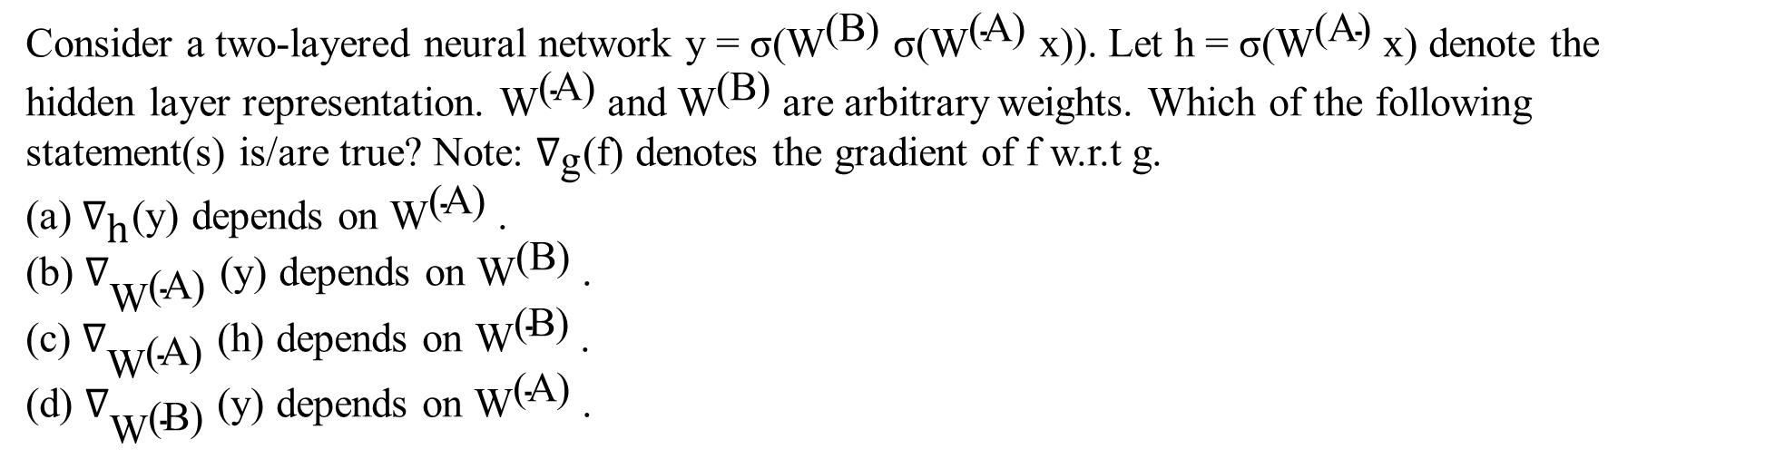
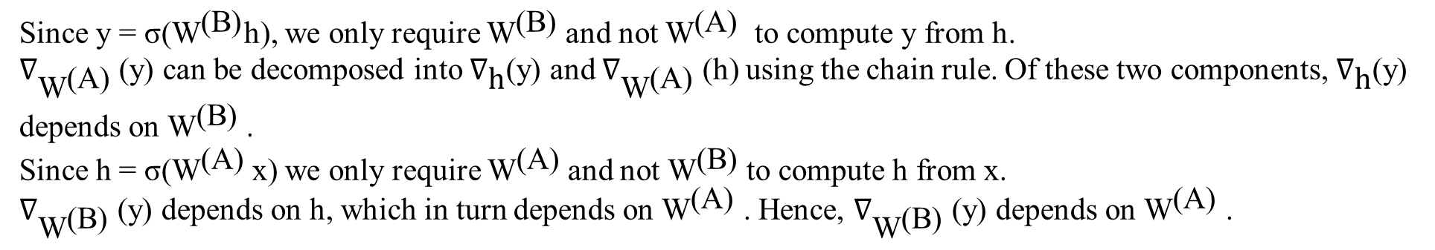
QUESTION 3
SOLUTION 3
CORRECT ANSWER 3
b), d)

Slide 17
QUESTION 4
Which of the following statement(s) about the initialization of neural network weights is/are
true?
a) Two different initializations of the same network could converge to different minima.
b) For a given initialization, gradient descent will converge to the same minima irrespective
of the learning rate.
c) The weights should be initialized to a constant value.
d) The initial values of the weights should be sampled from a probability distribution.
SOLUTION 4
Since the loss surface of a neural network is highly non-convex, it has multiple local minima.
Hence, different initializations or learning rates may result in convergence to different minima.
If the weights are initialized to a constant value, all the neurons in a layer will learn similar features. To avoid this, the initial values should be sampled from a distribution.
CORRECT ANSWER 4
a), d)

Slide 18
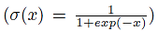
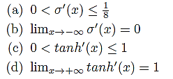
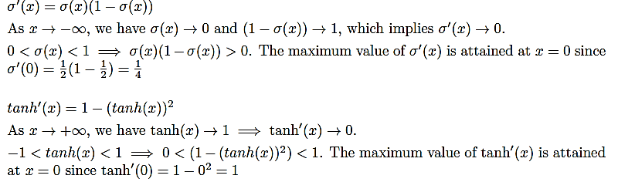
QUESTION 5
Consider the following statements about the derivatives of the sigmoid
and tanh
activation functions. Which of these statement(s) is/are correct?
SOLUTION 5
CORRECT ANSWER 5
b), c)

Slide 19
QUESTION 6
Statement: Threshold function cannot be used as activation function for hidden layers.
Reason: Threshold functions do not introduce non-linearity.
(a) Statement is true and reason is false.
(b) Statement is false and reason is true.
(c) Both are true and the reason explains the statement.
(d) Both are true and the reason does not explain the statement.
SOLUTION 6
We cannot use threshold function in the hidden layers because
Limited information passing from one layer to next
Non-differentiable nature of these functions
CORRECT ANSWER 6
a)

Slide 20
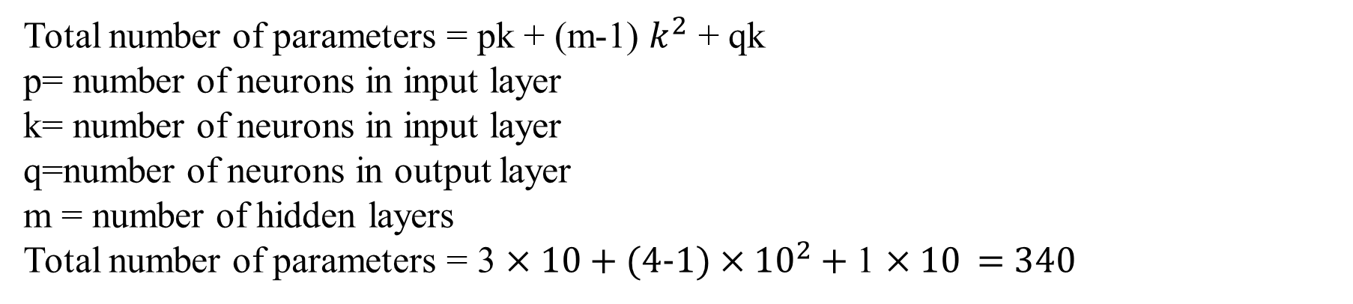
QUESTION 7
How many trainable parameters does a feedforward neural network contain for regression on a 3D input to generate a single scalar output, with 4 hidden layers, each consisting of 10 hidden units? Bias terms are disregarded.
(a) 440 (b) 340 (c) 330
(d) 430
SOLUTION 7
hidden
CORRECT ANSWER 7
b)

Slide 21
QUESTION 8
If the step size in gradient descent is too large, what can happen?
Overfitting
The model will not converge
We can reach maxima instead of minima
None of the above
SOLUTION 8
Algorithm taking excessively large steps may oscillate around the minimum or even diverge altogether, preventing it from converging to the optimal solution.
CORRECT ANSWER 8
b)

Slide 22
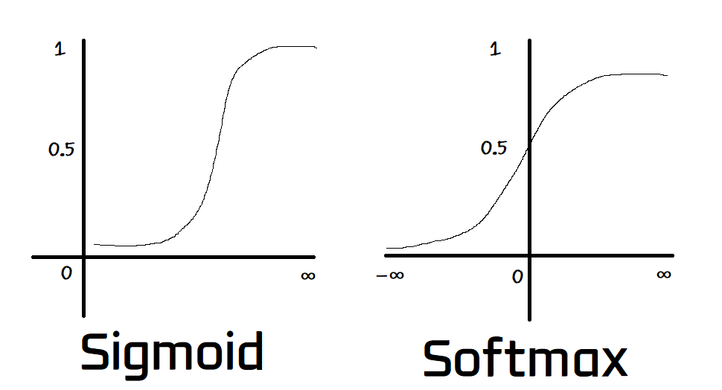
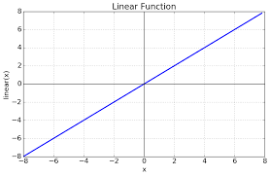
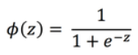
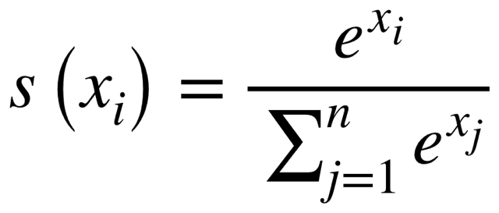
QUESTION 9
The last layer of ANN is linear for ________ and softmax for ________.
Regression, Regression
Classification, Classification
Regression, Classification
Classification, Regression`
SOLUTION 9
CORRECT ANSWER 9
c)

Slide 23



QUESTION 10
Which among the following statements is (are) true?
a) MAP estimates suffer more from overfitting than maximum likelihood estimates.
b) MAP estimates are equivalent to the ML estimates when the prior used in the MAP is a uniform prior over the parameter space.
c) Both (a) and (b)
d) None of the above
SOLUTION 10
CORRECT ANSWER 10
b)

